Slide 1
Shell Bootcamp 2024 - SOFT SKILLS 3 Reflections for Week 1 (26-Aug-2024 – 28-Aug-2024)
Hitesh
Date : 30-Aug-2024

Slide 2
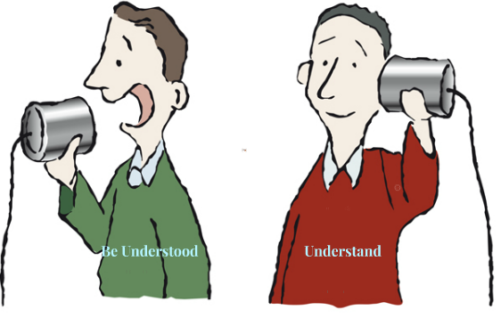
About Me
Seek to understand rather than to be understood.

Slide 3

My learnings from this week!

Slide 4
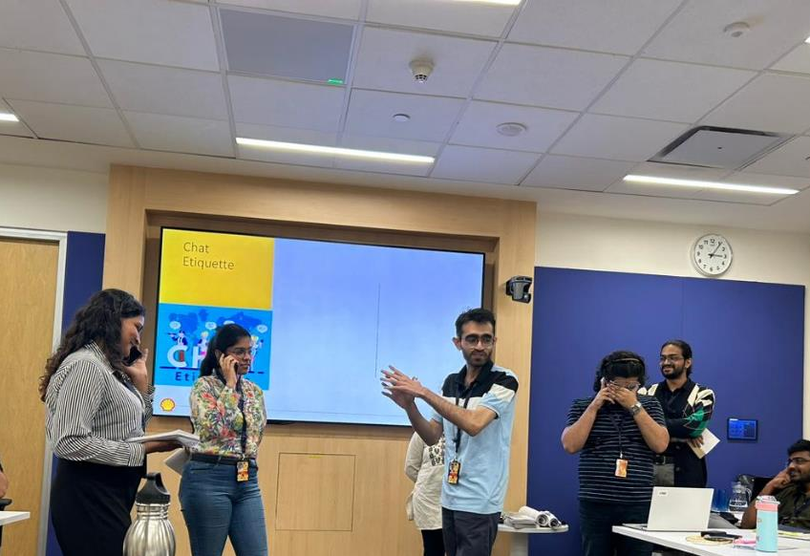
Learning 1 | My takeaways
Key learning
The first class of soft skills covers several crucial aspects of professional behaviour. It emphasizes the importance of attributes such as integrity, self-awareness, managing complexity, and maintaining a growth mindset. Additionally, it highlights the significance of grooming, effective communication, and proper etiquette in various professional settings, including telephone, chat, and video calls.
Key takeaway
Professionalism is multifaceted, encompassing not only technical skills but also how one conducts oneself in different situations. Key attributes include:
Integrity: Adhering to moral and ethical principles.
Self-awareness: Understanding one’s strengths and weaknesses.
Managing Complexity: Being able to handle complex situations effectively.
Growth Mindset: Believing in the ability to develop skills through effort and practice.
Effective Communication: Clear and respectful communication in all forms.
Grooming: Maintaining a neat and professional appearance.
Activities
First Activity: Managing Complexity in the Professional Environment
In this activity, we created a poster or chart as a team of six people, focusing on managing complexity in business, ideology, team dynamics, and technical aspects. This exercise helped us understand the multifaceted nature of complexity in professional settings and how to address it effectively.
Second Activity: Role Play on Mobile Etiquette
We performed a role play in teams of six, demonstrating the dos and don’ts of telephone/mobile conversations. We created two sets of scenes, each showing four scenarios of proper and improper mobile conversation etiquette. This activity highlighted the importance of effective communication and proper etiquette in maintaining professionalism.
How do I personally see this concept implemented in the Energy sector
In the Energy sector, professionalism is essential due to the high stakes in safety, environmental impact, and financial investments. Professionals must exhibit integrity, effective communication, and a commitment to continuous learning to manage complex challenges and drive innovation. A growth mindset aids in adapting to new technologies, while clear communication ensures adherence to safety protocols.

Slide 5
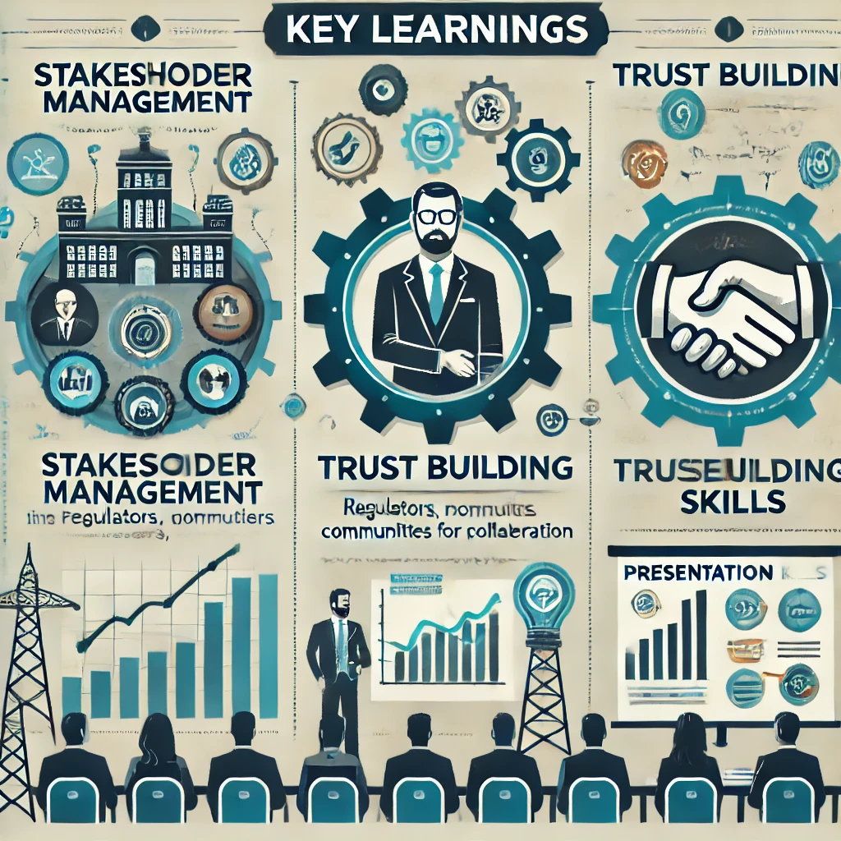
Learning 2 | My takeaways
Key learning
Understanding and managing stakeholder relationships is key to ensuring project success, as it enhances alignment, improves risk management, and fosters positive relationships.
Building trust within teams and with external stakeholders can significantly enhance collaboration, decision-making, and overall project success.
Key takeaway
Proactive stakeholder management can significantly improve project outcomes by ensuring that all parties are engaged, informed, and aligned towards common goals.
Trust leads to faster communication, reduced conflicts, and a more positive working environment, which are critical for high-performing teams.
How do I personally see this concept implemented in the Energy sector
In the energy sector, engaging diverse stakeholders like regulators, communities, and investors is key. Effective management ensures project compliance and support from influential parties.
Trust is crucial in high-stakes energy projects with complex collaborations. Building trust with team members and stakeholders leads to smoother operations and better project outcomes.
Activity
In a team of seven, we reviewed Sarah’s efforts to revitalize her university’s Environmental Club through rebranding, partnerships, and events. We identified stakeholders (students, faculty, admin, local groups) and classified them using the Power-Interest Grid: inform (low interest students), collaborate (active members), monitor (general student body), and satisfy (admin, local partners).
In a team of seven, we role-played stakeholders in GreenWave Energy’s "Ocean Horizon" project, each representing different interests like regulators, investors, and environmental groups. As the CTO and Environmental Advisor, I advocated for sustainable practices while negotiating to align diverse stakeholder priorities and reach a consensus on project goals.

Slide 6
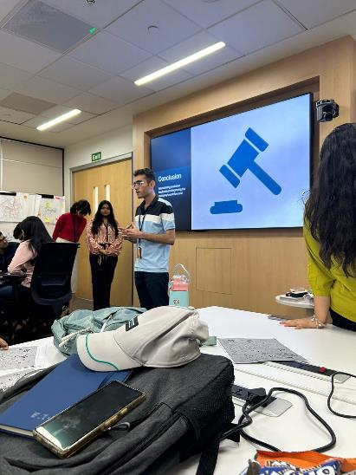
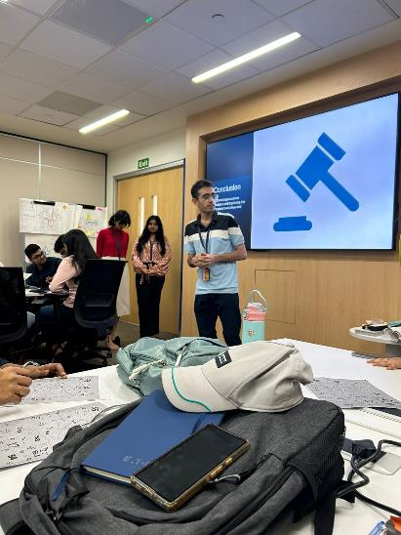
Learning 3 | My takeaways
Key learning
Teamwork:
Team Development: Recognize and navigate the phases of team development (Forming, Storming, Norming, Performing).
Team Player Traits: Emphasize synchronization and dedication.
Growth Mindset: Foster continuous learning and adaptability.
Feedback Mechanisms: Use the Sandwich Framework for constructive feedback.
Hybrid Teams: Apply best practices for effective virtual and hybrid team collaboration.
Presentation Skills:
Effective Presentation: Focus on audience, content organization, design, and delivery.
5Ps: Profile, Pitch, Pace, Pause, and Practice.
Content Structuring: Use Problem-Solution-Benefit and the Rule of Three.
Key takeaway
Mastering teamwork and presentation skills is crucial for professional success, enhancing productivity, innovation, and communication.
How do I personally see this concept implemented in the Energy sector
Teamwork:
Project Management: Manage multidisciplinary teams effectively.
Innovation: Foster innovation and problem-solving.
Remote Collaboration: Enhance hybrid team collaboration.
Presentation Skills:
Stakeholder Communication: Deliver clear presentations to stakeholders.
Training: Improve employee training with structured content and engaging delivery.
Activities
In a team of six, we participated in a "Mumble Jumble" activity where we had to form a sentence using chits of words. The challenge included missing or extra letters, requiring us to trade pieces with other teams in the room to complete our task. Our final sentence was "Good Teams get to go together.“
In a team role-play, I narrated a feedback session addressing a member's interjections during a meeting on Diwali bonus targets and leave requests. The sandwich feedback method was used to ensure the message was constructive.
In a team of six, we prepared a PPT for an existing client on addressing customer concerns. We used a scenario with "Rocket Monkey," a startup graphic apparel company, planning workflow and website changes. I designed the PPT, presented the customer retention projections, and concluded the presentation.

Slide 7

Relevance of learnings for my organization

Slide 8

Learning 1 | Relevance for Shell
How I feel Shell implements this learning
Shell integrates professionalism into its culture by upholding integrity, self-awareness, and effective communication. The company promotes a growth mindset and values proper grooming and etiquette in all professional interactions.
How I feel Shell benefits from this learning
These practices enhance Shell’s professionalism and efficiency, fostering trust, innovation, and smooth stakeholder interactions. They contribute to effective project management and a positive corporate image.

Slide 9
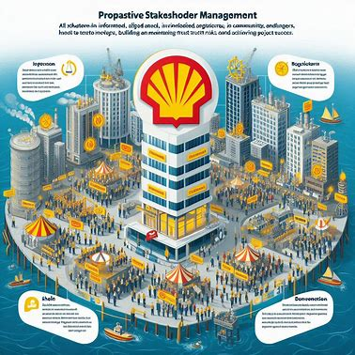
Learning 2 | Relevance for Shell
How I feel Shell implements this learning
Shell prioritizes proactive stakeholder management by engaging with a wide range of parties, including regulators, communities, and investors. The company ensures all stakeholders are informed, aligned, and involved in project goals, which helps in managing risks and achieving project success. Building and maintaining trust with these stakeholders is also a key focus, fostering collaboration and effective decision-making.
How I feel Shell benefits from this learning
By implementing effective stakeholder management, Shell enhances project outcomes through better alignment and support. Trust within and outside the organization leads to smoother operations, reduced conflicts, and improved collaboration, which are essential for managing complex energy projects and maintaining a positive working environment.

Slide 10
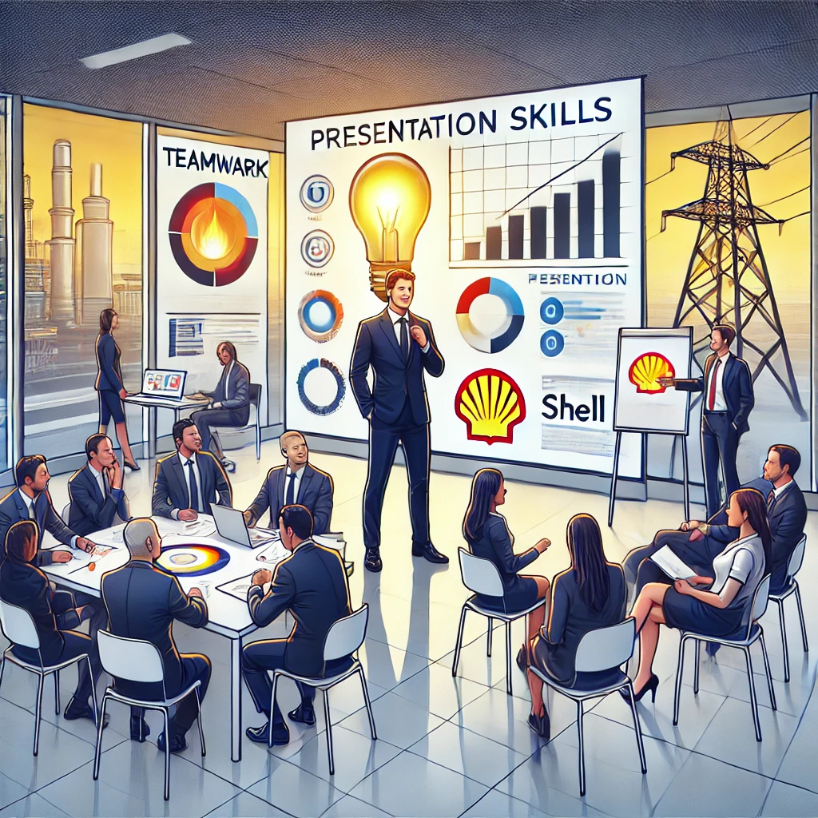
Learning 3 | Relevance for Shell
How I feel Shell implements this learning
Teamwork: Shell uses the Tuckman model to guide team development and emphasizes a growth mindset for continuous learning. The company fosters collaboration in hybrid and multidisciplinary teams, leveraging diverse expertise to tackle complex projects.
Presentation Skills: Shell values clear, structured presentations to engage stakeholders effectively. By focusing on the 5Ps (Profile, Pitch, Pace, Pause, Practice), Shell ensures that presentations are impactful, aligning goals and building trust.
How I feel Shell benefits from this learning
Teamwork: Effective teamwork at Shell enhances productivity, innovation, and project outcomes. Constructive feedback mechanisms maintain high morale and foster continuous improvement.
Presentation Skills: Strong presentation skills help Shell communicate complex ideas clearly, build trust with stakeholders, secure project approvals, and enhance Shell's reputation in the energy sector.

Slide 11

Challenges in implementing learning

Slide 12
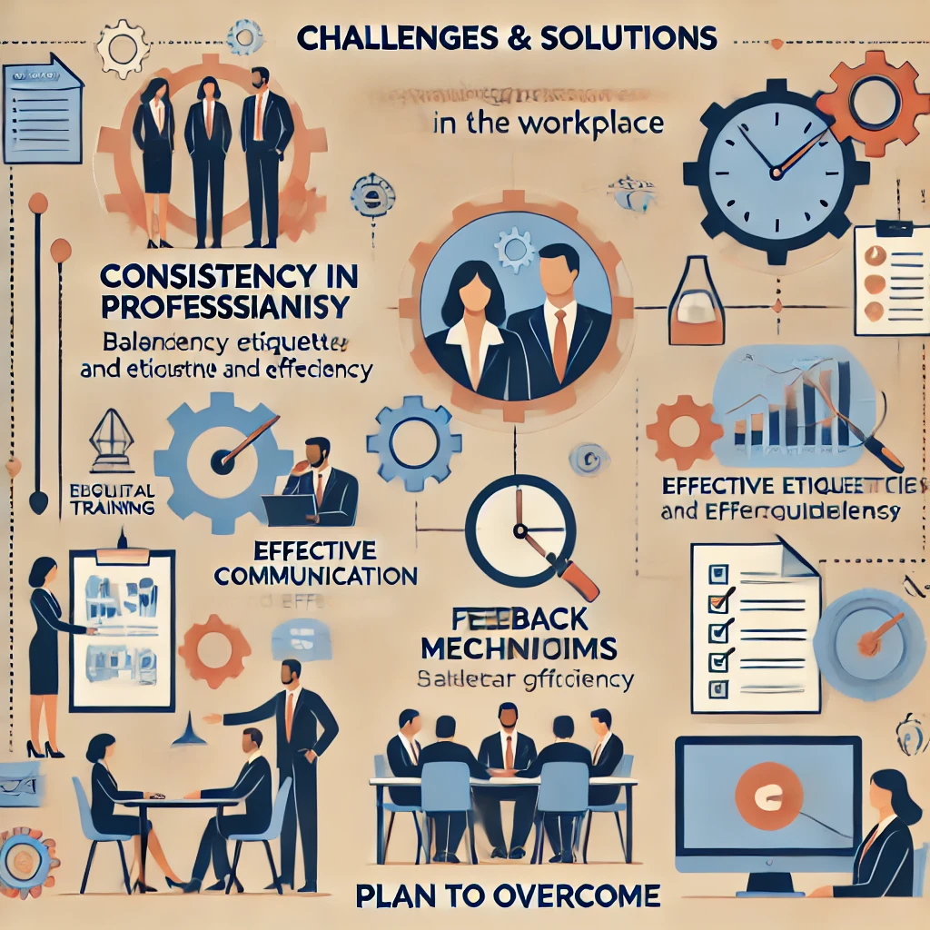
Challenge faced while implementing Learning 1
Challenges While Implementing Learning 1:
Consistency in Professionalism: Ensuring consistent adherence to professional standards across diverse team interactions and settings can be challenging.
Effective Communication: Maintaining clarity and respect in communication, especially in virtual settings, requires ongoing effort and skill development.
Balancing Etiquette and Efficiency: Finding the right balance between formal etiquette and the need for efficient communication in fast-paced environments can be difficult.
Plan to Overcome Challenges:
Regular Training: Implement regular soft skills training and refreshers to reinforce the importance of professionalism and ensure consistent application.
Feedback Mechanisms: Establish feedback systems to continuously improve communication practices and address any issues promptly.
Clear Guidelines: Develop and communicate clear guidelines on professional behavior and etiquette, ensuring that all team members are aware of and adhere to them.

Slide 13
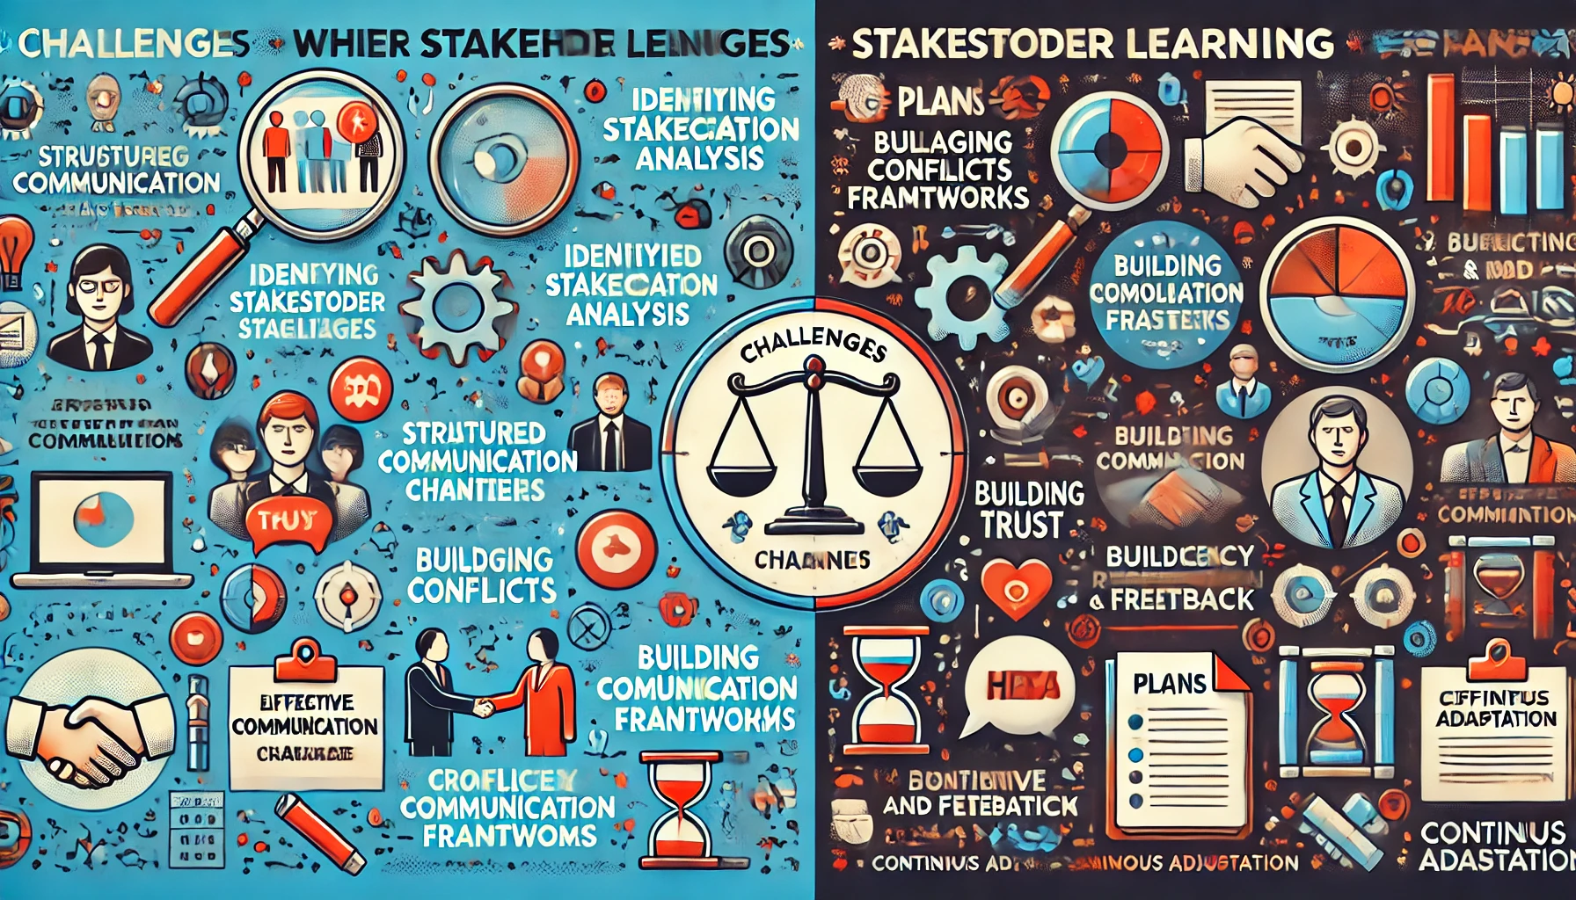
Challenge faced while implementing Learning 2
Challenges While Implementing Learning 2:
Identifying Stakeholders: Accurately identifying and understanding the priorities of all relevant stakeholders was difficult, especially when interests conflicted.
Managing Conflicts: Balancing diverse interests among stakeholders, like regulators, investors, and environmental groups, often led to disagreements that were challenging to resolve.
Building Trust: Establishing and maintaining trust with stakeholders was a gradual and complex process, requiring consistent communication and transparency.
Effective Communication: Ensuring clear and consistent communication across all stakeholders to avoid misunderstandings was a significant challenge.
Plan to Overcome Challenges:
Structured Stakeholder Analysis: Use tools like Stakeholder Mapping to better categorize and engage stakeholders effectively.
Clear Communication Channels: Establish dedicated communication methods, such as regular updates and centralized dashboards, to keep stakeholders informed and aligned.
Conflict Resolution Frameworks: Implement formal conflict resolution techniques, like facilitated discussions, to address and resolve stakeholder conflicts.
Transparency and Feedback: Foster trust by maintaining transparency, sharing updates openly, and actively seeking stakeholder feedback.
Continuous Adaptation: Regularly review and adapt engagement strategies based on feedback and lessons learned to improve stakeholder management.

Slide 14
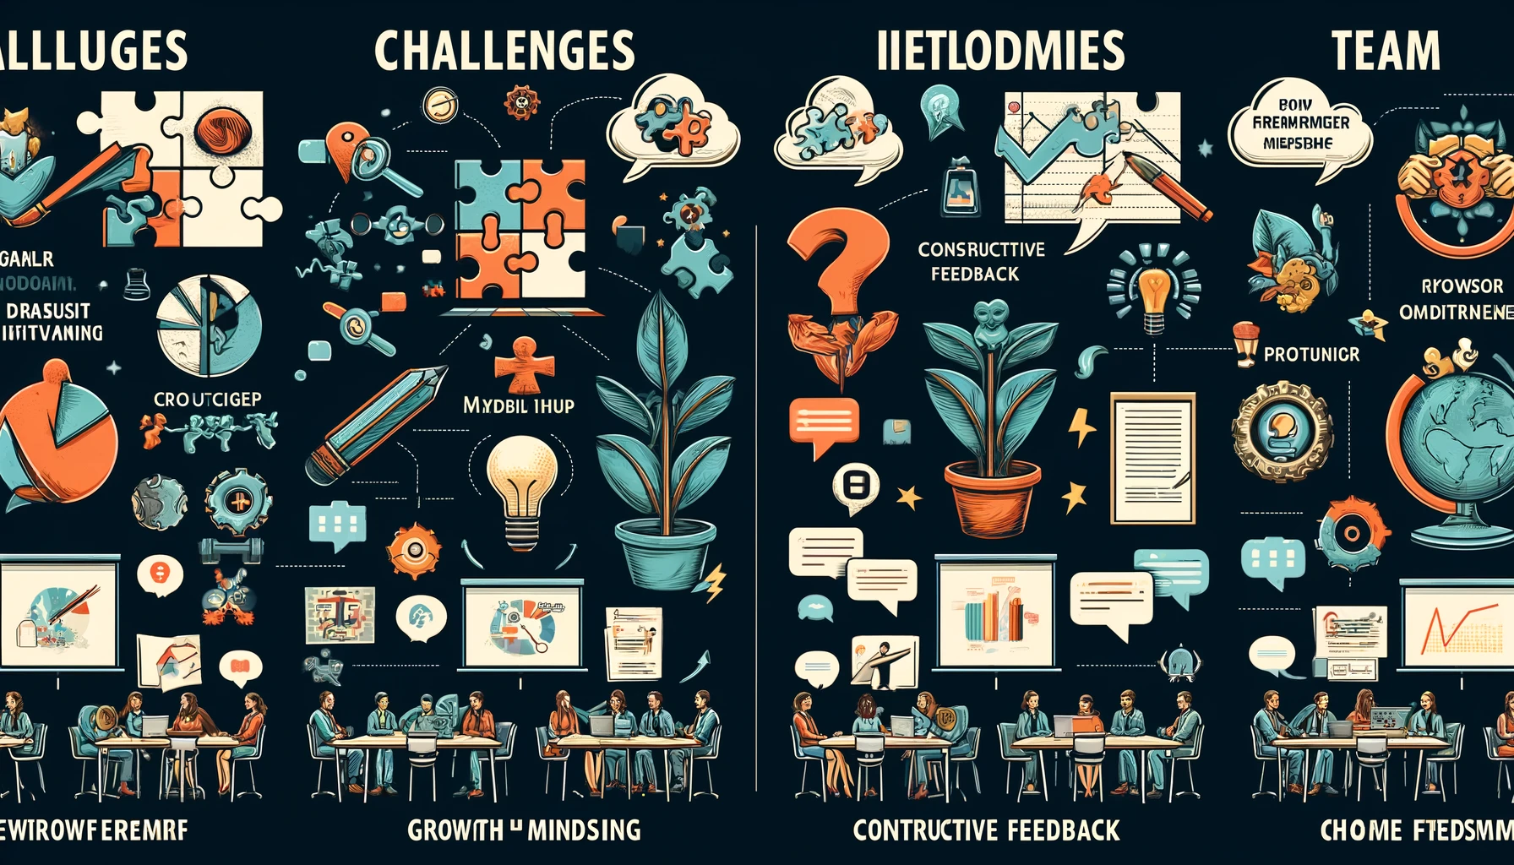
Challenge faced while implementing Learning 3
Challenges While Implementing Learning 3:
Team Coordination: Managing conflicts during team development stages was difficult.
Growth Mindset: Encouraging adaptability among resistant team members was challenging.
Constructive Feedback: Balancing feedback without softening the message was tough.
Hybrid Teams: Ensuring engagement in hybrid setups led to communication gaps.
Presentation Clarity: Structuring and delivering clear, engaging presentations was not always easy.
Plan to Overcome Challenges:
Team Workshops: Facilitate team-building sessions for better coordination.
Foster Learning: Integrate ongoing learning and recognize adaptability.
Feedback Training: Practice giving and receiving feedback effectively.
Enhance Hybrid Communication: Use interactive tools and clear protocols.
Presentation Practice: Regularly rehearse with peer feedback to improve clarity and delivery.

Slide 15

Action Plan

Slide 16
My Action Plan for this Week
Actions
Timeline
Status
Attend workshops and interact with colleagues and team members.
Apply learning from the Shell bootcamp in your routine work tasks.
Read "7 Habits of Highly Effective People" by Stephen Covey and "Success Through a Positive
Throughout the week.
Daily.
Set aside time each day to read.
Planned.
In progress.
Ongoing.

Slide 17

Learning is also Fun!

Slide 18
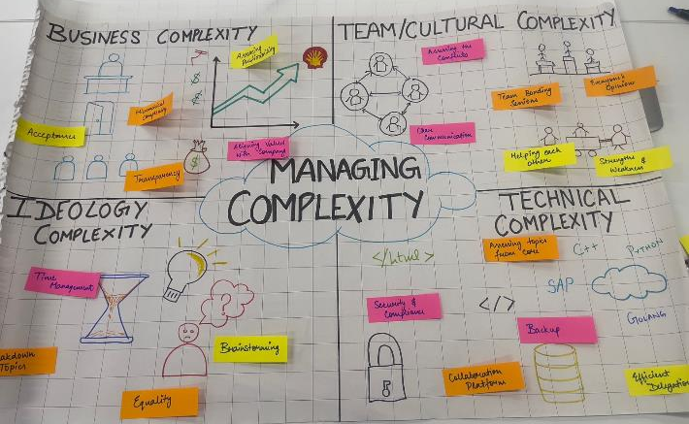
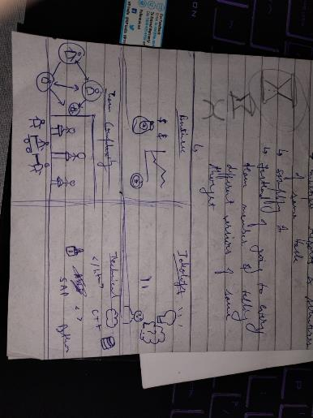
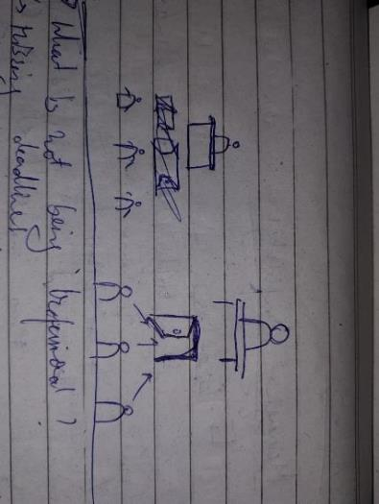
Learning is also Fun!
How Your Learning Was Fun This Week:
Learning was engaging and enjoyable this week with hands-on activities and role-playing exercises that made complex concepts more accessible and fun.
Group Activity:
In a team of six, we created a poster on managing complexity in professional settings. This collaborative exercise emphasized teamwork and problem-solving.
Funny Incident with New Learning:
During the "Mumble Jumble" activity, we had to form a sentence with scrambled words, leading to some humorous mix-ups. It highlighted the importance of communication and teamwork in a lighthearted way.

Slide 19

Summary
Quick summary
Transitioning from college to the corporate world requires more than just adapting to new tasks; it demands a shift in mindset, embracing continuous growth, and refining interpersonal skills. These elements, coupled with effective stakeholder management and professional grooming, are critical for a seamless transition into corporate life.
Importance of topics of upcoming week
Next week's focus on technical training will be a vital step in bridging the gap between theoretical knowledge and practical application. This technical foundation will empower us to tackle real-world challenges with confidence and precision, ensuring that we’re not just prepared, but also proactive in our roles.
Connectivity of topics from current week
The skills we honed this week, from stakeholder management to professional conduct, will serve as the backbone for our upcoming team activities. The adaptability, trust, and communication strategies we’ve practiced will be key to successfully navigating the technical challenges ahead, ensuring that we collaborate effectively and complete projects smoothly.

Slide 20
Thank You

Slide 21
Shell Bootcamp 2024 – TECHNICAL FOUNDATION Reflections for Day 1 (29-Aug-2024)
Hitesh
Date : 30-Aug-2024

Slide 22
My learnings from this week!

Slide 23
Learning 1 | My takeaways
Introduction to Business Analysis
Definition: According to the International Institute of Business Analysis (IIBA), business analysis is the practice of enabling change within an organizational context.
Business: An organization that provides products or services to satisfy customer needs with the objective of making a profit.
Analysis: A systematic examination.
SDLC Model (Software Development Life Cycle)
Planning: Involves business analysts to define requirements.
Design and Prototyping
Software Development
Testing
Deployment
Operations and Maintenance
Requirement Analysis
Definition: The process of defining user expectations for a new or modified software.
Types:
Functional Requirements: Describe what the product does (mandatory).
Non-Functional Requirements: Describe how the product works (non-mandatory).
Key Learning: Never assume; always ask. This was emphasized through a team activity where we modeled a paper airplane.

Slide 24
Learning 2 | My takeaways
Requirement Elicitation
Definition: The practice of researching and discovering the requirements of a system from users, customers, and other stakeholders. Also known as “requirement gathering.”
Top Techniques:
Brainstorming
Document Analysis
Requirement Modeling
Types:
Class-Based
Data-Based
Top Management Techniques
Work Breakdown Structure (WBS): Essential for effective project planning, execution, controlling, monitoring, and reporting.
Gantt Charts
Critical Path Method
Waterfall Model
Kanban
Scrum
Requirement Traceability: Ensures each business need is tied to an actual requirement and each requirement is tied to a deliverable.

Slide 25
Learning 3 | My takeaways
Waterfall Model
Stages: Requirements, Design, Development, Testing, Deployment, Maintenance.
Advantages: Simple, easy to understand, good for small requirements, and works well when quality is more important than cost or schedule.
Disadvantages: Cannot go back to previous stages, customers see the product only at launch, no demos involved.
When to Use the Waterfall Model?
Requirements are well-known.
Product definition is stable.
Technology is understood.
Developing a new version of an existing product.
Porting an existing product to a new platform.
Agile Methods
Examples: Adaptive Software Development, Feature Driven Development, Scrum, Extreme Programming, Kanban.
Benefits of Scrum
Adaptability, continuous improvement, sustainable pace, motivation, faster problem resolution, customer-centric, high velocity, efficient development process.

Slide 26
Learning 4 | My takeaways
Scrum Flow
Sprint: A 2-4 week period to accomplish a goal.
Roles:
Product Owner
Scrum Master
Scrum Team Members
Stakeholders
Daily Scrum: A 15-minute daily meeting to review progress.
Sprint Retrospective: A meeting at the end of each sprint to review achievements and plan improvements.
Scrum Events
Sprint Planning: Deciding what can be delivered within a sprint and what work is needed.
Daily Scrum: Reviewing progress toward the sprint goal.
Sprint Review: Reviewing achievements at the end of each sprint and adapting the product backlog if needed.
Sprint Retrospective: Inspecting the team’s performance and creating a plan for improvements.

Slide 27
Learning 4 | My takeaways
Product Backlog for Planning
Project planning is based on a product backlog containing functions and technology enhancements.
Meetings:
To decide features for the next sprint.
To plan out the work.
Scrum Queues
Uses lightweight queue-based management and work breakdown mechanisms.
The Sprint
Definition: The basic unit of development in Scrum.
Duration: One week to one month.
“Time-Boxed”: Effort of a constant length.
Setting Up Azure DevOps
Details on setting up and using Azure DevOps for project management and development.

Slide 28
Thank You

Slide 29
Shell Bootcamp 2024 – TECHNICAL FOUNDATION Reflections for Day 2 (30-Aug-2024)
Hitesh
Date : 30-Aug-2024

Slide 30
My learnings from this week!

Slide 31
Learning 1 | My takeaways
Epic - Story - Task - Sub Task
Epic: Think of an Epic as a large story that needs to be broken down into multiple smaller stories.
Story: A requirement detailed enough to be estimated.
Task: Developers and testers break down the story into tasks to estimate, develop, and test it.
Sub Task: These are smaller chunks of a parent task, assigned and tracked individually.
Enabler and Spike Story
Enabler: Supports activities needed to extend the architectural runway for future business functionality.
Spike: A time-boxed user story or task created to research a question or resolve a problem.
Activity Done for Enabler Story
Story Pointing
Story points measure the effort required to complete a piece of work.
The team assigns story points based on complexity, amount, and uncertainty.
Definition of Ready
Defines the criteria a user story must meet before it can be picked up for a sprint.

Slide 32
Learning 2 | My takeaways
Scrum Board
Also known as a sprint board, it’s a visual representation of work to be done in a single sprint.
Agile Workflow
Agile Product Roadmap
Time Estimation
Logging Work
Why Kanban Board?
Why Use Fibonacci Numbers?
Fibonacci numbers get farther apart as they increase, making estimation easier.
Burn Up Charts vs. Burndown Charts
Velocity Charts

Slide 33
Thank You

